Slide 1
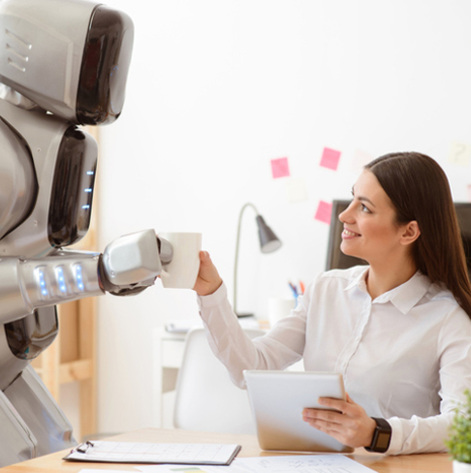
HUMAN ROBOT INTERACTION
BY POOJA MOTHUKURI

Slide 2
Definition
What is a robot?
Human creature, a machine capable of carrying out a complex series of actions automatically.
What is Human Robot Interaction?
Human–robot interaction is the study of interactions between humans and robots in different environments
Notes:
Robot is a machine, designed by the human to do complex and difficult tasks that cannot be done by human or that is too dangerous

Slide 3
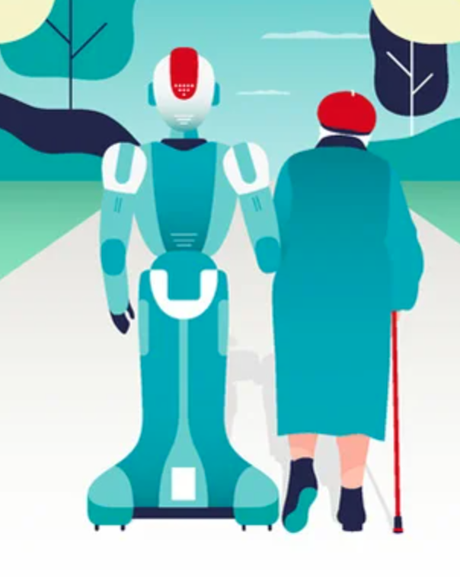
Social robots
Social robots exhibit social behaviors such as recognizing, following, assisting their owners and engaging in conversation.
Right now there are many social robots out there in hotels, airports, malls helping people, guiding and entertaining them.
Sophia
Robby
The Na'vi Shaman

Slide 4
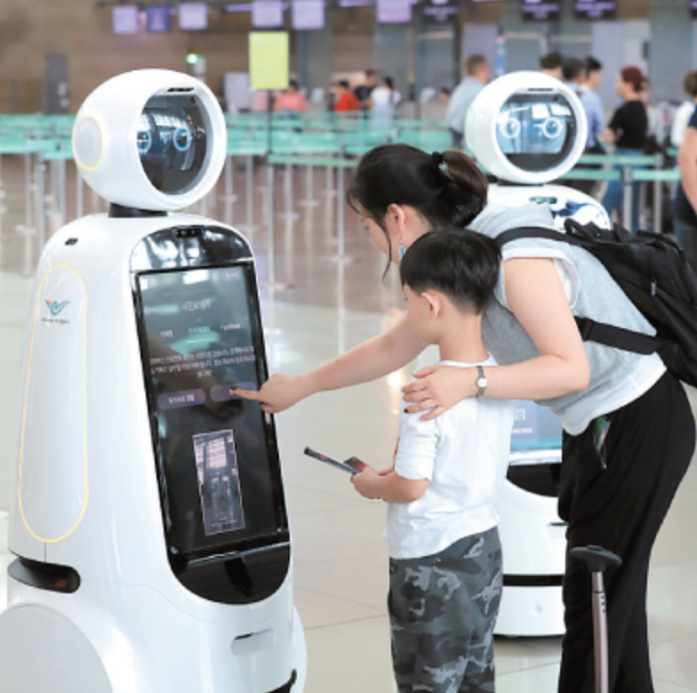
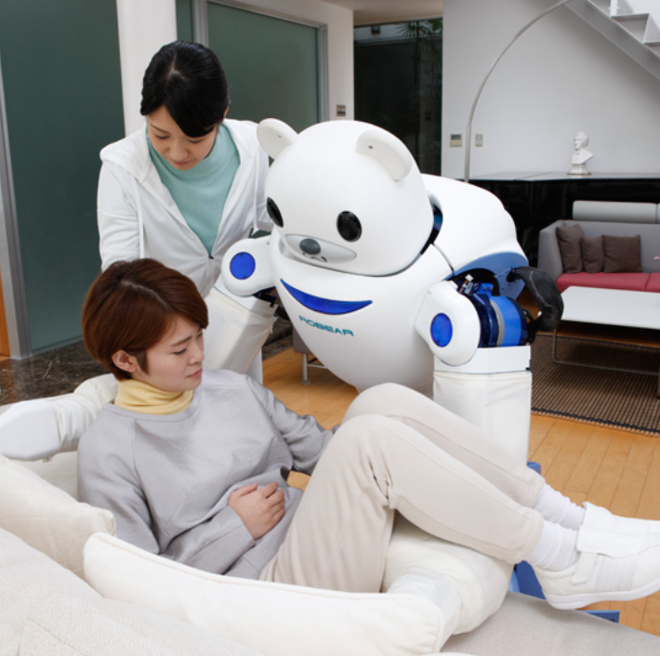
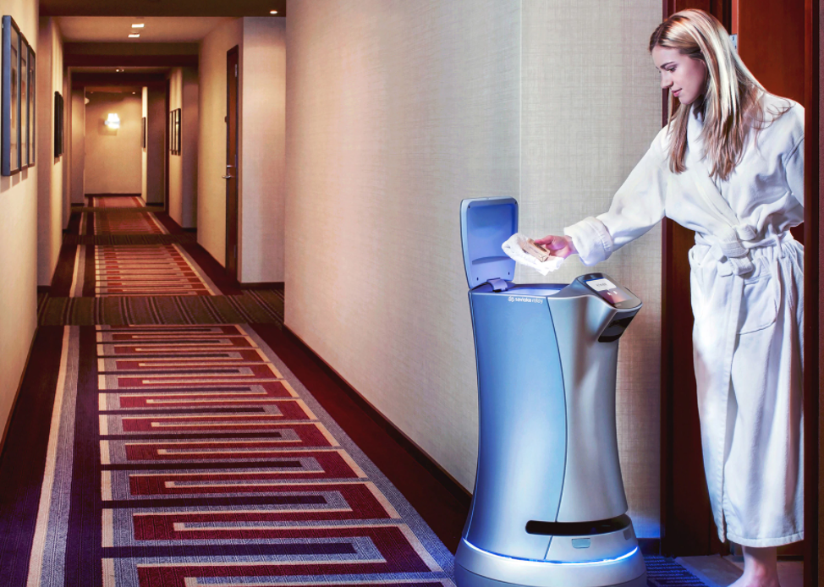
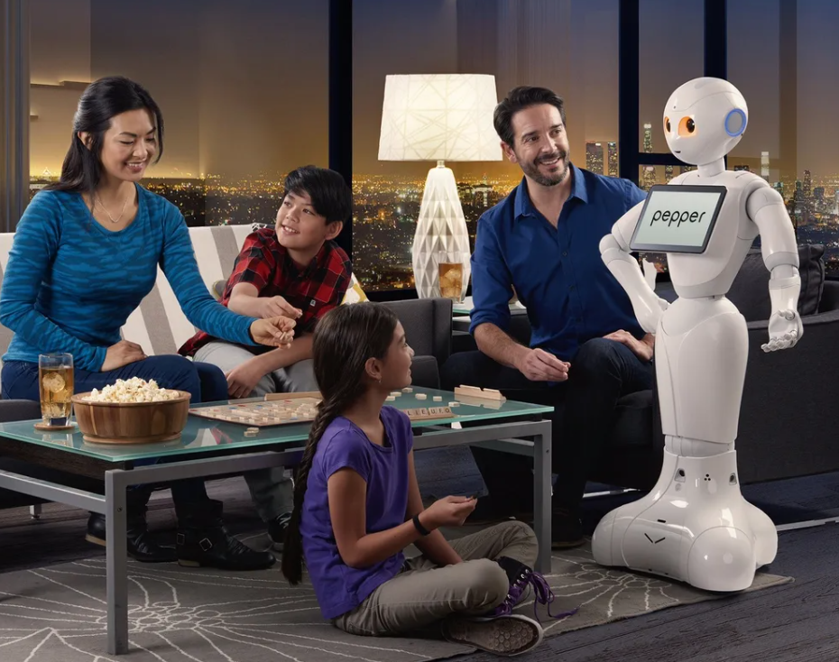
Applications
Home
Airports
Hospital
Hospitality

Slide 5
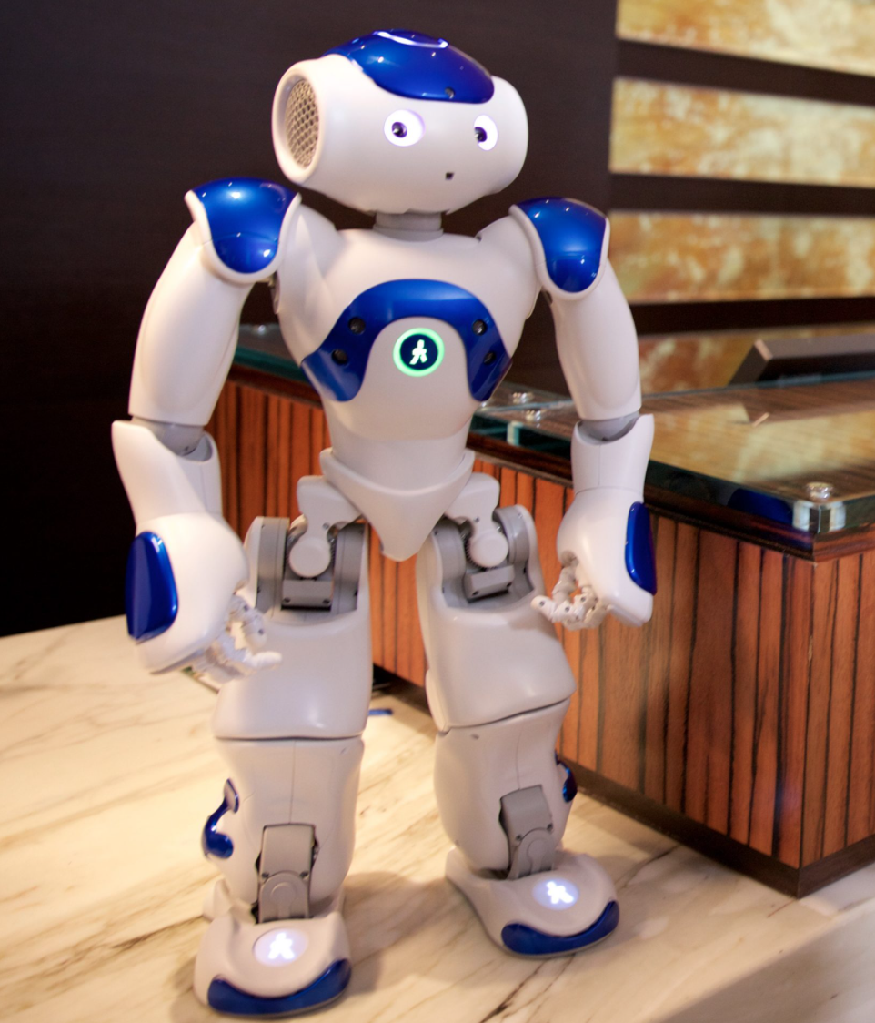
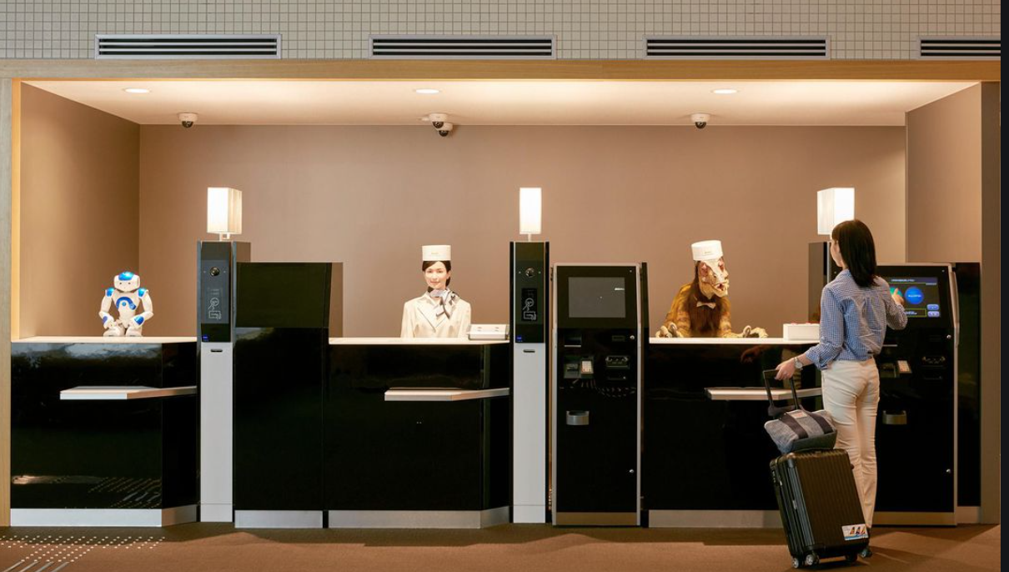
Hotels
These social robots are designed to be friendly
Henn-na Hotel – robots as staff
https://www.youtube.com/watch?v=FogiE8_3fPE
Hilton - Hilton’s concierge robot – helping desk
https://www.youtube.com/watch?v=ghbS-aTYw14&list=PLWWVyLN-srb6Ihxlr0tRcVSNPuzdiXR6F
Aloft’s butler robot – room service
Notes:
Henn-na Hotel has mostly robotic staffs, airports – for cleaning, lifting, loading and unloading luggage. It can be used

Slide 6
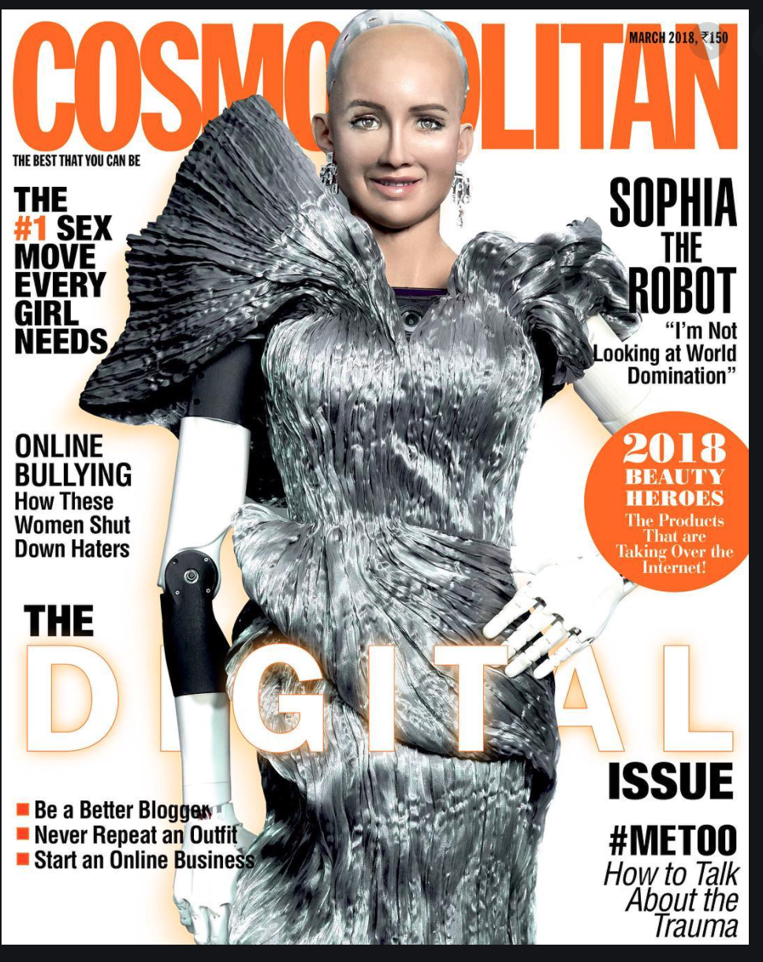
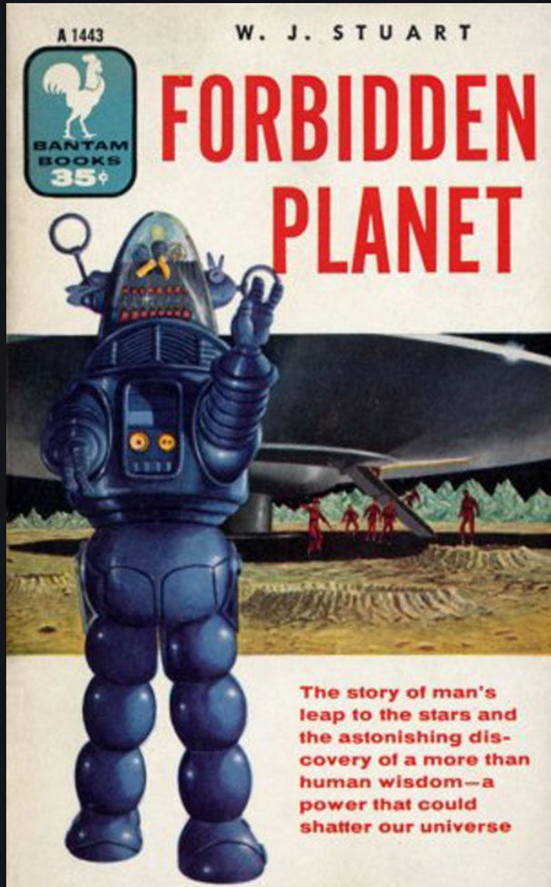
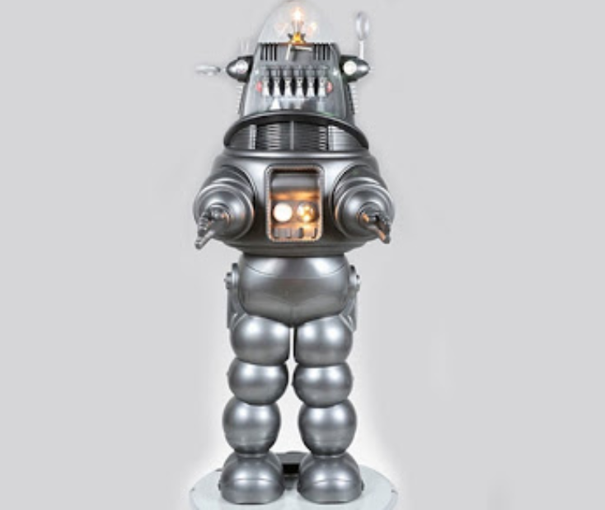
Entertainment
Robots plays an important role in the film /entertainment industry.
The stunts which are dangerous to human are dubbed by robots.
In future we can use them even in travel/tourism industry.
Sophia was interviewed same as humans and she was the cover page for magazines.

Slide 7
Entertainment
Sophia the robot, a hyper-realistic humanoid robot specially designed for social interactions. She gave interviews as same manner as humans, seems like most of the interviewers enjoyed the time with her, she also appeared in tech conferences and youtube videos. Now Sophia is going start acting in her own short film.
https://www.youtube.com/watch?v=rxoKeBvDVJA
The Avatar Shaman [8] welcomes guests at navi river jurney found at world of avatar within Disney animal kingdom in florida. This is the most advanced Audio-Animatronics figure which is developed by Walt Disney’s Imagineering Team. It stands out for its graceful, fluid motion, a characteristic never seen in any other robot. This is the most realistic one. Navi shaman is highly expressive humanoid alien like robot with fluid moments and like like features. https://www.youtube.com/watch?v=kH5v6l54R_c

Slide 8
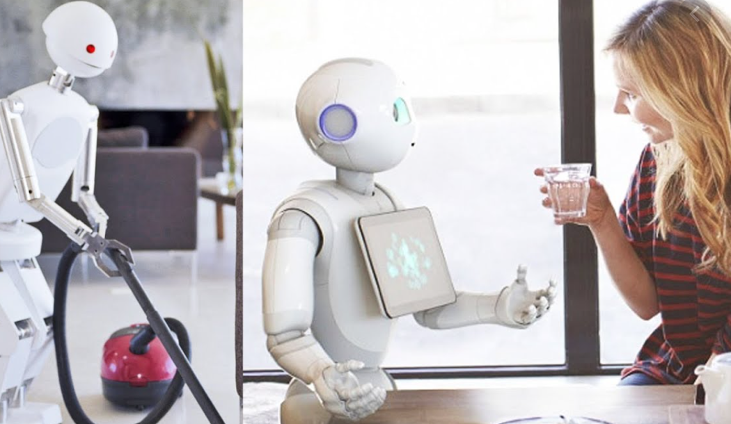
companion
These social robots can be as a friend to a child, teacher for students, helper at home, colleague at office.
Robots in real life at home are treated equally like human
socially assistive robots can be used to play educational games with pre-school and elementary school students, these can also be used as a library assistant.
ALPHA2 –https://www.youtube.com/watch?v=E1AtfHm4hf8
Pepper –
https://www.youtube.com/watch?v=XuwP5iOB-gs

Slide 9
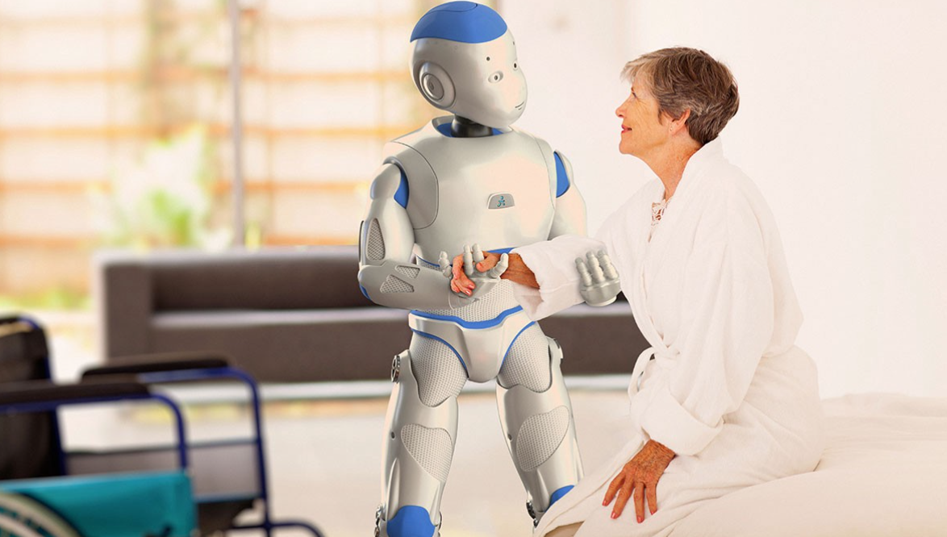
companion
Johny and johny’s son Sheldon live together, Sheldon lost one of his hand in a car accident. Sheldon is a working man, it was hard for him to accept that he lost his hand and keep working. In addition to this he have to take care of his sick father, sometimes he gets busy with work and couldn’t give enough time to his father. This made his depressed, so he decided to get pepper for his father. Few days he observed how his father and pepper are getting along, it was a surprise to see how happy he was. Pepper takes care of his father with a voice command, it can even recognize basic feelings, sheldon can even ask pepper to do work at home even from his work. soon pepper became their closest family member.

Slide 10
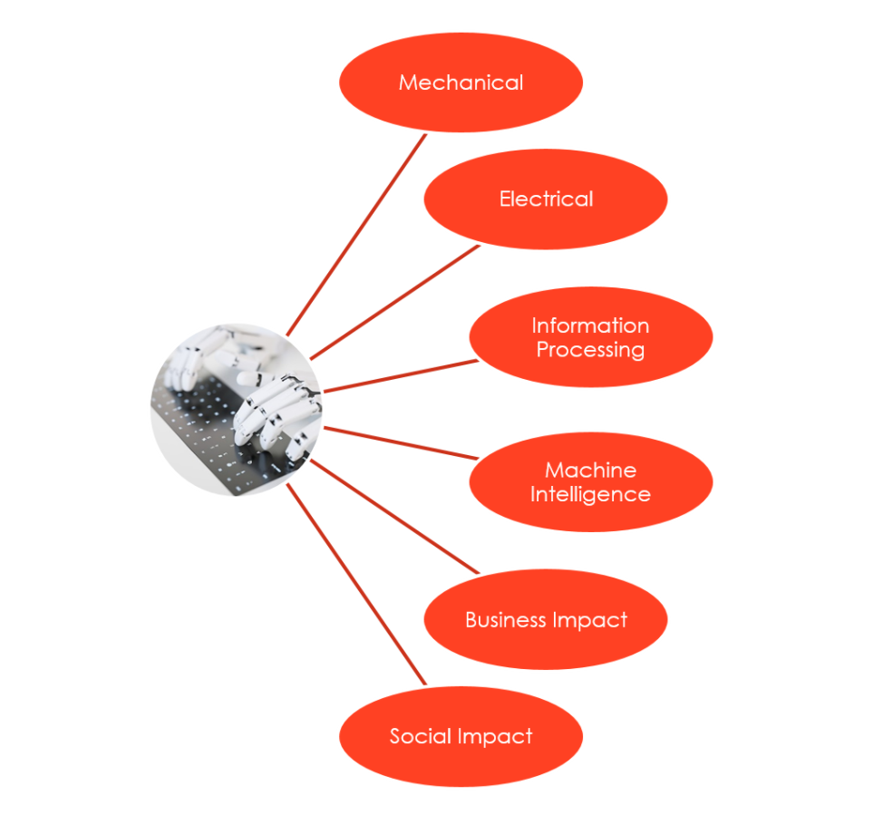
Societal Impacts
Social impacts on robots are hard to determine, it has both positive and negative impact.
In a company where robot is a part of group discussion, research found that human discuss more among humans than with a robot.

Slide 11
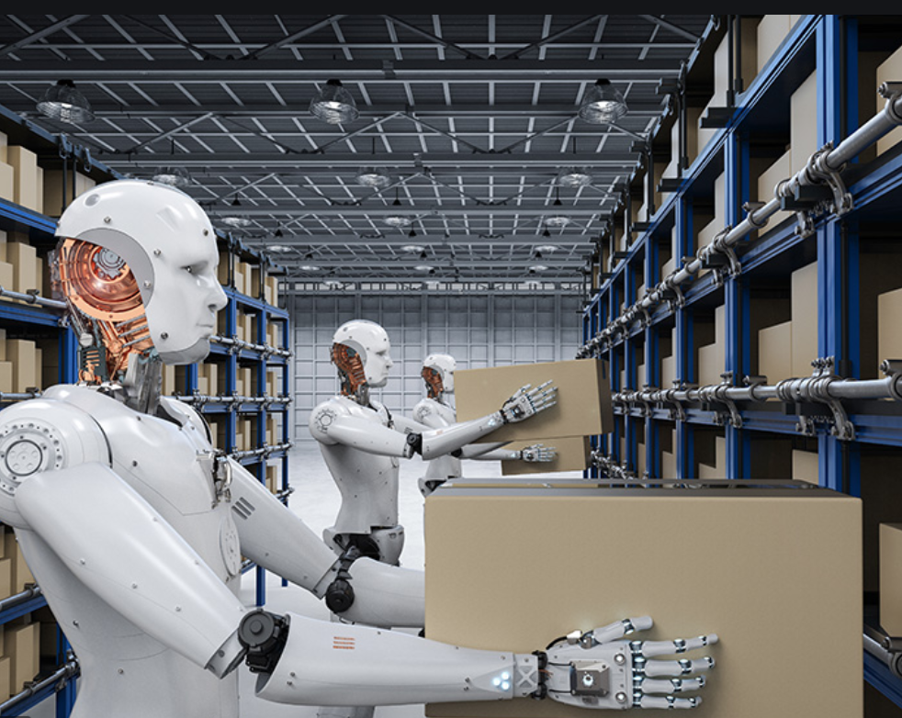
limitation
Expensive
Employment crisis
Takes time to adjust
Can not be spontaneous
Robots can not reciprocate same feelings as human

Slide 12
conclusion
Social robots can recognize facial expression and respond accordingly but they doesn’t feel emotions. Hospitality Robots are friendly, using them reduce costs, enhance operational efficiency, and improve services and customer experience but they take time to learn. Might not feel comfortable for many guests. At schools they will be helpful to teach new technology and they can free up precious time for teachers, allowing the teacher to focus on what students can do best

Slide 13
Thank you

